Slide 1
SEARCH ENGINE COMP-8547 ADVANCED COMPUTING CONCEPTS
INSTRUCTOR: DR MAHDI FIROOZJAEI
TEAMMATES: DEVAM K. JANI, 110087329
HARSH P. KESHRUWALA, 110087334
STEEVE NAZARETH, 110087871
JAY PATEL, 110088120

Slide 2
TABLE OF CONTENTS
INTRODUCTION
STRUCTURE
CONCEPTS AND PRACTICE
DEMO
CONCLUSION

Slide 3
1. INTRODUCTION

Slide 4
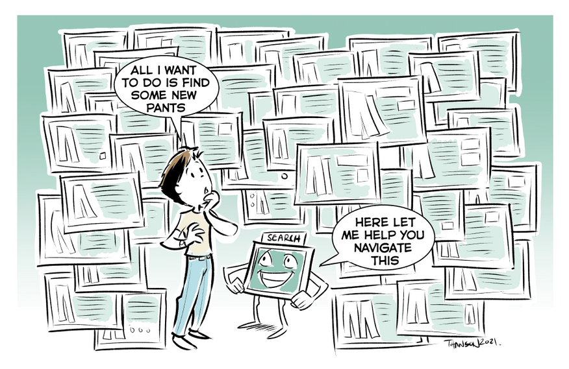
WHAT IS A SEARCH ENGINE?
A software system to perform web search.
A web service that searches the internet (often known as the “WWW") for information based on a user's search
REFERENCE: https://neeva.com/learn/what-is-a-search-engine

Slide 5

SOME WIDELY-USED SEARCH ENGINES
REFERENCE: https://www.reliablesoft.net/top-10-search-engines-in-the-world/

Slide 6

CORE MODULES OF A SEARCH ENGINE
Web Crawler
Indexer
Crawling Program
Ranker
Database Management System (DBMS)
Search Engine User Interface (SEUI)
REFERENCE: https://www.istockphoto.com/vector/isometric-businessman-hand-use-tablet-to-searching-keyword-on-search-engine-gm1025271302-275048990

Slide 7
2. STRUCTURE

Slide 8
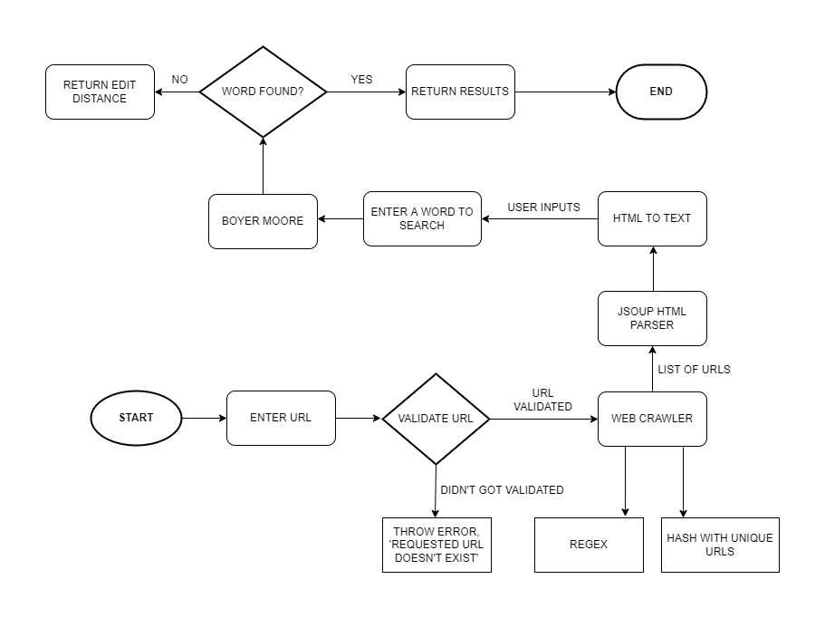
FLOW CHART

Slide 9
3. CONCEPT AND PRACTICE

Slide 10
EACH TEAMMATE’S RESPONSIBILITY
DEVAM K. JANI – BOYER MOORE
HARSH P. KESHRUWALA – WORD SEARCH
STEEVE NAZARETH – HTML PARSER, PAGE RANKING
JAY PATEL – WEB CRAWLER

Slide 11
WEB CRAWLER

Slide 12
HTML PARSER

Slide 13
EDIT DISTANCE

Slide 14
BOYER MOORE

Slide 15
4. DEMO

Slide 16
5. CONCLUSION

Slide 17
The following tools are utilised in this project: Web Crawl, HTML to TXT conversion, TXT document preprocessing, Word frequency, Inverted Index, and Spell Checker. We support this via the usage of hashtables, queues, TSTs, and other data structures.
The search engine uses a certain method to retrieve information from the Internet and provides feedback to the user of a search technology in accordance with the user's needs and a particular algorithm.

Slide 18
THANK YOU

